Slide 1



Unit- 1
Green skilling and Sustainability

Slide 2
Chapters for Discussion
Chapter - 1
Overview of sustainability and Definitions and Importance
Chapter - 2
Green skilling and its importance in the context of sustainability
Chapter - 3
Green Entrepreneur

Slide 3

Overview of sustainability: Definitions and Importance
Chapter
1

Slide 4


DISCLAIMER
The content is curated from online/offline resources and used for educational purpose only.

Slide 5

Learning Objectives
By the end of this presentation, participants will be able to:
Understand the role of green skills in supporting sustainable economies and tackling environmental challenges.
Explain key environmental concepts like ecological and carbon footprints, and ways to reduce them.
Analyze strategies for promoting environmental literacy, sustainable practices, and resource management.
Recognize the role of governments, institutions, and global agreements (e.g., Paris Agreement, SDGs) in sustainability efforts.
Apply sustainable practices in daily life and business, such as waste reduction and energy conservation.
GOAL
Source :
www.freepik.com/
Notes:
Sustainable Development Goals (SDGs)
No Poverty: End poverty in all its forms everywhere.
Zero Hunger: End hunger, achieve food security, and promote sustainable agriculture.
Good Health and Well-being: Ensure healthy lives and promote well-being for all.
Quality Education: Ensure inclusive and equitable quality education.
Gender Equality: Achieve gender equality and empower all women and girls.
Clean Water and Sanitation: Ensure availability and sustainable management of water and sanitation.
Affordable and Clean Energy: Ensure access to affordable, reliable, sustainable, and modern energy.
Decent Work and Economic Growth: Promote sustained, inclusive, and sustainable economic growth.
Industry, Innovation, and Infrastructure: Build resilient infrastructure, promote inclusive industrialization.
Reduced Inequalities: Reduce inequality within and among countries.
Sustainable Cities and Communities: Make cities and human settlements inclusive and sustainable.
Responsible Consumption and Production: Ensure sustainable consumption and production patterns.
Climate Action: Take urgent action to combat climate change and its impacts.
Life Below Water: Conserve and sustainably use oceans and marine resources.
Life on Land: Protect, restore, and promote sustainable use of terrestrial ecosystems.
Peace, Justice, and Strong Institutions: Promote peaceful societies and access to justice for all.
Partnerships for the Goals: Strengthen global partnerships to support and achieve the goals.
Paris Agreement
Limit Global Warming: Keep the global temperature rise well below 2°C, ideally limiting it to 1.5°C above pre-industrial levels.
Enhance Climate Resilience: Increase the ability to adapt to adverse impacts of climate change.
Finance Flows: Align global financial flows with low-emission and climate-resilient development pathways.
Nationally Determined Contributions (NDCs): Countries submit their own climate action plans and update them every 5 years.
Global Stocktake: A review process every 5 years to assess collective progress.

Slide 6
Sustainable Practices and Resource Management
Sustainability refers to the ability to meet the needs of the present without compromising the ability of future generations to meet their own needs.
Why is Sustainability Important?
1
Environmental Preservation
Sustainability ensures responsible usage of natural resources.
2
Sustainable Economic Development
A sustainable approach can lead to stable and enduring economic growth.
3
Equity and Social Justice
Social sustainability aims to enhance the quality of life for all.
4
Resilience and Adaptation
Sustainability aids in building more resilient societies and economic systems.
5
Legacy for Future Generations
Itʼs crucial to meet the present needs without compromising the ability of future generations to meet their own needs
Source :
www.freepik.com/
Notes:
Sustainable Practices and Resource Management
Sustainability is the need satisfaction of the current generation without risking the ability of future generations to meet their needs.
Though it is a relatively new word, the definition of sustainability credited comes from Our Common Future, a report from 1987 by the United Nations (U.N.) Brundtland Commission. This landmark report was the culmination of years of data gathering and hearings with scientists, researchers, industry leaders, and governments around the world. It concluded that, to be able to solve diverse global environmental crises, the world needed to treat them as "interlocking crises" that must be addressed with holistic, sustainable solutions.
Clearly, sustainability is important to making our world habitable. However, for us to successfully take action to achieve a healthy balance between human needs and the capabilities of the Earth, there must be actual strides on waste reduction, conservation of natural resources, and keeping ecosystems healthy. Fortunately, people, organizations, and governments around the world set ambitious goals for doing this.
Why is Sustainability Important?
Sustainability is pivotal for several reasons, ranging from environmental protection to promoting social equity and economic stability. Some key points regarding the importance of sustainability are:
Environmental preservation: This lies at the heart of the sustainability approach, where there should be responsible use of natural resources including, but not limited to, water, forests, and minerals so that these things are not depleted. Essential factors with regard to attaining this sustainability include cutting down greenhouse gas emissions as well as reliance on renewable energy to combat climate change.
Sustainable economic development: Sustainability can lead to sustainable and steady long-run economic growth due to innovation and efficiency. For instance, clean technology and renewable energy sources can directly create employment.
Equity and social justice: Social sustainability talks about equity and social justice, with the passage of time forwarding to developing a quality life for everyone, starting off with basic services such as health and education. Instead, they talk about equity and inclusion that try to narrow the differences in social and economic terms between the social classes.
Resilience and adaptation: Sustainability enables the production of more resilient societies and economies that are better prepared to face unforeseen crises such as natural disasters or recessions and depressions.
Legacy for future generations: This is premised on the principle of sustainable development whereby present needs are met without compromising the ability of future generations to meet their own needs.
Awareness and education: It also promotes greater knowledge and awareness on human impacts on the world, this has the potential to result in long-term positive behavioral changes over time.

Slide 7
Types of Sustainability
The three pillars of sustainability are environmental, economic, and social.
Environmental Sustainability
Focuses on the conservation of biodiversity without foregoing economic and social progress.
Economic Sustainability
Social Sustainability
Has the goal of strengthening the cohesion and stability of specific social groups.
Refers to the organization's ability to manage its resources and responsibly generate profits in the long term.
Source :
Images are generated by AI tool
Notes:
Types of Sustainability
According to the report compiled by the Intergovernmental Panel on Climate Change, even if the emissions of greenhouse gases are drastically cut off as of today, global warming is still likely to reach 1.5°C soon. This global warming might bring disastrous consequences, such as melting glaciers, disappearance of animal and plant species, start of forest fire and drought, etc.
Therefore, human being as well as business entities are significantly involved in the fight against climate changes and many activities for sustainability. Sustainability, however is not environmental only; sustainability has to be brought about in many other ways also. In this context, it would like to be highlighted that sustainability assumes various forms.
The three pillars of Sustainability are Environmental Sustainability, Economic Sustainability and Social Sustainability.
Environmental sustainability
Environmental sustainability focuses on the conservation of biodiversity without giving up economic and social development. Foundations of Environmental Sustainability: Preserve water, save energy, reduce waste, use recyclable packs, limit or eliminate usage of plastics, sustainable transport, reuse paper, flora and fauna preservation.
A great example of environmental sustainability is Swachh Bharat Abhiyan (Clean India Mission): This large-scale campaign aims to ensure sanitation and waste management, promoting a cleaner environment and improving public health.
Economic sustainability
In the case of a setting a company, the time that a company is developed involves setting the expenses and revenues. After a balance between these two factors is struck, the company makes profits. Economic sustainability is the ability of the organisation to responsibly utilize its resources and produce long-term profits.
For example, Unilever is the company which, in 2010, started a program to maintain the set balance between sustainability and economic performance of the company. Some measures to maintain the set condition were raising package recycling, encouraging the usage of recycled materials, and campaigns regarding responsible consumption.
Social sustainability
In any community in which economic activities are carried out in a specific environment, we find three interconnected forms of sustainability: environmental, economic, and social. In other words, social sustainability in particular has the goal of strengthening the cohesion and stability of specific social groups.
The government runs several programs, such as Mahatma Gandhi National Rural Employment Guarantee Scheme, which provides employment and social security for disadvantage groups.
Programs like Ayushman Bharat offer millions of customers access to reduced healthcare, which has improved health access for the disadvantaged to quality medical care.

Slide 8
How to Apply the Three Pillars of Sustainability
The three pillars of sustainability serve as a practical framework for making decisions that balance the needs of people, the planet, and prosperity.
Environment
Does this program have a net positive impact on the environment?
Social
Is this initiative good for all people?
Economic
Is this project financially self-sustaining
Source :
www.freepik.com/
Notes:
How to Apply the Three Pillars of Sustainability
The three pillars of sustainability—environmental, social, and economic—are the key framework for making decisions about how much weight people, the planet, and prosperity will get. Each pillar needs to be interpreted differently, but a helpful way to consider the three pillars is by using it more as a checklist on which sustainable decision-making or analysis can be checked off in different areas.
For example, think of the scenario where we were urban planners considering a new curbside recycling program in our city. Let's apply the three pillars to ask relevant questions, considerations, and impacts:
Environmental: Does this initiative net positively on the environment? For example, is recycling more impactful on the environment, what are the environmental emissions as you drive around in a hopefully electric vehicle to pick up items? Indirect environmental impact?
Social: Is this initiative good for all people? Who benefits? Is it fair and equitable to everyone? Are there any unintended consequences or social impacts?
Economic: Is the project financially sustainable? For instance, if it costs us more money to recycle each item than we have in our program budget from taxes or other funding, our initiative might be great for the environment and society, but still not pass the economic sustainability test.
The three pillars inside companies can be used as a guiding model toward strategy corporate social responsibility (CSR), social impact, ESG (environment social governance), and sustainability strategy, prioritization, and decision-making.
Ultimately, when all the three pillars of sustainability are achieved and balanced, the governments, organizations, projects, and other initiatives towards the development would be more robust, resilient, long-lasting, and successful. Sustainable living is all of our collective responsibility, and the three pillars of sustainability can be a useful framework for making the right, sustainable decisions as well as asking and analyzing the right questions about what's truly sustainable.

Slide 9
Sustainable Practices for Resource Management
Sustainable practices and resource management focus on using natural resources efficiently to meet current needs without compromising the ability of future generations to meet their own.
Principles of Sustainable Resource Management
Resource Efficiency
Optimizing the use of natural resources.
Circular Economy
Transitioning from a linear economy to a circular model.
Life Cycle Assessment (LCA)
Evaluating the environmental impact of a product or process
Source :
www.freepik.com/
Notes:
Sustainable Practices for Resource Management
Sustainable practices and resource management focus on using natural resources efficiently to meet current needs without compromising the ability of future generations to meet their own. This concept extends to both the personal and organizational levels, emphasizing the need for mindful consumption, waste reduction, and ecological stewardship.
Principles of Sustainable Resource Management
Resource Efficiency: Optimizing the use of natural resources (energy, water, raw materials) to maximize their benefits and reduce waste.
Circular Economy: Transitioning from a linear economy (take, make, dispose) to a circular model, where resources are reused, repaired, and recycled to minimize waste.
Life Cycle Assessment (LCA): Evaluating the environmental impact of a product or process from cradle to grave (production to disposal) and implementing strategies to reduce its footprint at each stage.

Slide 10

Energy Conservation and Efficiency
Renewable Energy: Use solar, wind, hydro, and biomass to lower fossil fuel dependence and reduce emissions.
Energy-efficient Tech: Promote energy-saving devices like LED lighting, smart appliances, and IoT energy management.
Green Building: Design buildings with optimized natural light, ventilation, insulation, and renewable energy integration.
Demand-side Management (DSM): Encourage reduced energy use during peak times for better grid efficiency.
Source :
https://blog.shoptexaselectricity.com/significance-of-energy-conservation-why-it-matters/
Notes:
Energy Conservation and Efficiency
Renewable Energy Sources: Utilizing solar, wind, hydro, and biomass energy to reduce reliance on fossil fuels and minimize carbon emissions.
Energy-efficient Technologies: Promoting energy-saving devices and systems such as LED lighting, energy-efficient appliances, and smart energy management systems (e.g., IoT-enabled devices).
Green Building Practices: Designing and constructing buildings that optimize natural light, ventilation, and insulation, and incorporate renewable energy sources.
Demand-side Management (DSM): Programs encouraging consumers to reduce their energy usage during peak demand periods to improve grid efficiency.
Examples:
Implementation of energy-saving measures in households or organizations to cut down electricity consumption.
Case studies showcasing businesses transitioning to renewable energy sources to meet their operational needs.

Slide 11
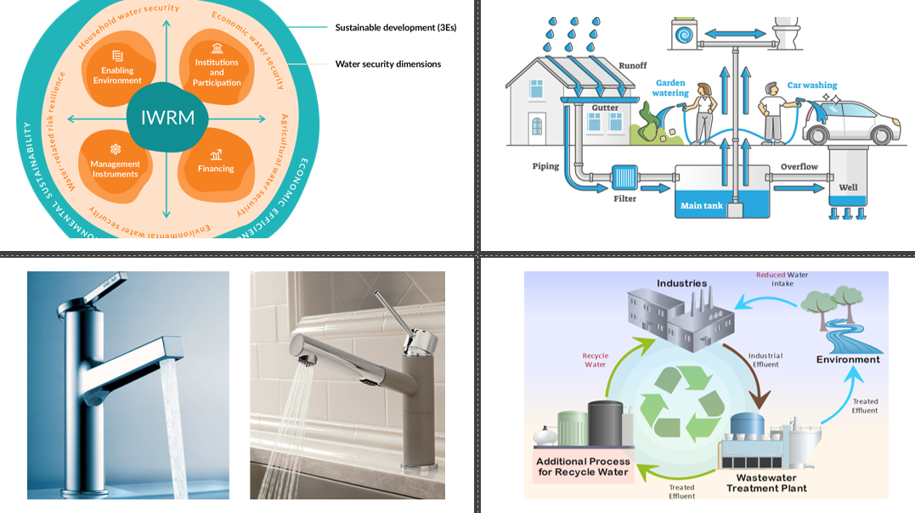
Water Conservation and Management
Water-efficient Tech: Use low-flow faucets, toilets, and water-saving appliances to reduce waste.
Rainwater Harvesting: Collect and store rainwater for irrigation, cleaning, and non-potable uses.
Wastewater Recycling: Reuse greywater and treated wastewater for industry, agriculture, and landscaping.
Integrated Water Resource Management (IWRM): Manage water resources holistically to balance social, economic, and environmental needs.
Source :
https://savethewater.org/rooftop-rainwater-harvesting-an-ancient-and-sustainable-technique-for-water-management/
Notes:
Image sources:
https://www.remodeling.hw.net/products/kitchen-bath/water-saving-products-whats-new-in-low-flow-faucets
https://savethewater.org/rooftop-rainwater-harvesting-an-ancient-and-sustainable-technique-for-water-management/
https://green.org/2024/01/30/the-economics-of-wastewater-reuse/
https://iwrmactionhub.org/about/iwrm-explained
Water Conservation and Management
Water-efficient Technologies: Installation of low-flow faucets, toilets, and water-efficient appliances (washing machines, dishwashers) to reduce water wastage.
Rainwater Harvesting: Collecting and storing rainwater for reuse in irrigation, cleaning, and other non-potable applications.
Wastewater Treatment and Reuse: Recycling greywater and treated wastewater for industrial, agricultural, and landscaping purposes.
Integrated Water Resource Management (IWRM): Holistic management of water resources that balances social, economic, and environmental objectives.
Examples:
Large-scale adoption of rainwater harvesting systems in urban areas or industries.
Government policies or community initiatives aimed at sustainable groundwater management.

Slide 12

Waste Management and Recycling
3Rs (Reduce, Reuse, Recycle): Minimize resource use, creatively reuse products, and recycle waste into new products.
Composting: Convert organic waste into nutrient-rich compost, reducing chemical fertilizer use.
E-Waste Recycling: Properly recycle electronics to recover materials and prevent environmental contamination.
Zero Waste: Cut landfill waste by redesigning processes, enhancing product durability, and maximizing recycling.
Source :
Image generated using AI tool
Notes:
Waste Management and Recycling
Reduce, Reuse, Recycle (3Rs): Encouraging minimal resource consumption (reduce), creative reuse of products (reuse), and processing waste materials into new products (recycle).
Composting and Organic Waste Management: Composting food and organic waste to create nutrient-rich soil additives that reduce the need for chemical fertilizers.
E-Waste Recycling: Managing electronic waste (old computers, phones, batteries) through proper recycling channels to recover valuable materials and prevent harmful chemicals from contaminating the environment.
Zero Waste Practices: Reducing waste to landfill by redesigning production processes, improving product durability, and maximizing recycling efforts.
Examples:
Municipal or corporate recycling programs.
Innovations in waste-to-energy systems that convert waste materials into electricity or fuel.

Slide 13
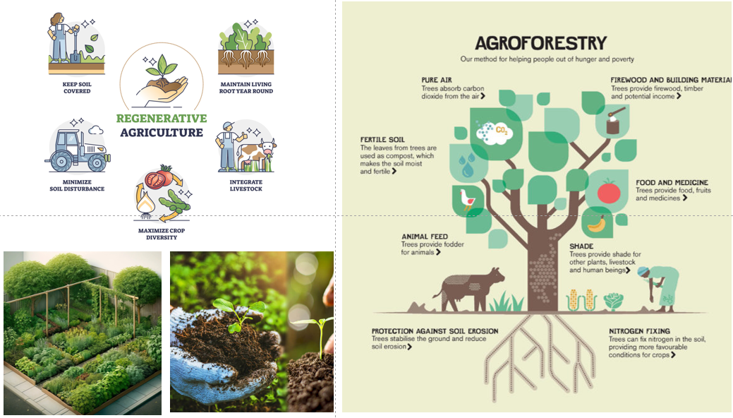
Sustainable Agriculture and Land Use
Permaculture: Create agricultural systems that mimic ecosystems, supporting biodiversity and soil health.
Regenerative Agriculture: Use farming methods that restore soil, boost biodiversity, and capture carbon.
Agroforestry: Integrate trees into farmland to improve biodiversity, soil stability, and resource efficiency.
Organic Farming: Use natural fertilizers, crop rotation, and pest control to sustain soil fertility.
Source :
https://www.moore-unidrill.com/what-is-regenerative-farming/
Notes:
Image sources:
https://www.moore-unidrill.com/what-is-regenerative-farming/
https://deepgreenpermaculture.com/permaculture/permaculture-design-principles/7-small-scale-intensive-systems/
https://viagroforestry.org/what-we-do/agroforestry/
https://www.khetivyapar.com/en/organic-farming-sustainable-organic-farming-50
Sustainable Agriculture and Land Use
Permaculture: Designing agricultural systems that mimic natural ecosystems, promoting biodiversity, soil health, and resource conservation.
Regenerative Agriculture: Farming techniques that restore soil health, increase biodiversity, and capture carbon to combat climate change.
Agroforestry: Integrating trees and shrubs into agricultural lands to enhance biodiversity, soil stability, and resource efficiency.
Organic Farming: Reducing chemical inputs by relying on natural fertilizers, crop rotation, and biological pest control to maintain long-term soil fertility.
Examples:
Organic farms employing regenerative practices to restore ecosystems while producing crops.
Governments or organizations providing incentives for sustainable farming practices.

Slide 14
Behavioral and Cultural Change for Sustainability
Education and Awareness Campaigns
Corporate Social Responsibility (CSR)
Community-led Initiatives
Promoting environmental literacy and resource conservation behaviors.
Companies adopting sustainability as a core value.
Grassroots movements encouraging sustainable lifestyles
Source :
https://www.linkedin.com/pulse/what-corporate-social-responsibility-csr-why-matters-govrncorp
Notes:
Behavioral and Cultural Change for Sustainability
Education and Awareness Campaigns: Promoting environmental literacy and resource conservation behaviors through campaigns in schools, workplaces, and communities.
Corporate Social Responsibility (CSR): Companies adopting sustainability as a core value, implementing green policies, and encouraging employees to participate in sustainability efforts.
Community-led Initiatives: Grassroots movements encouraging sustainable lifestyles, such as local clean-up drives, tree-planting events, or carpooling networks.
Examples:
Awareness campaigns targeting consumers to reduce single-use plastic.
Companies encouraging employees to adopt eco-friendly commuting or office practices.

Slide 15
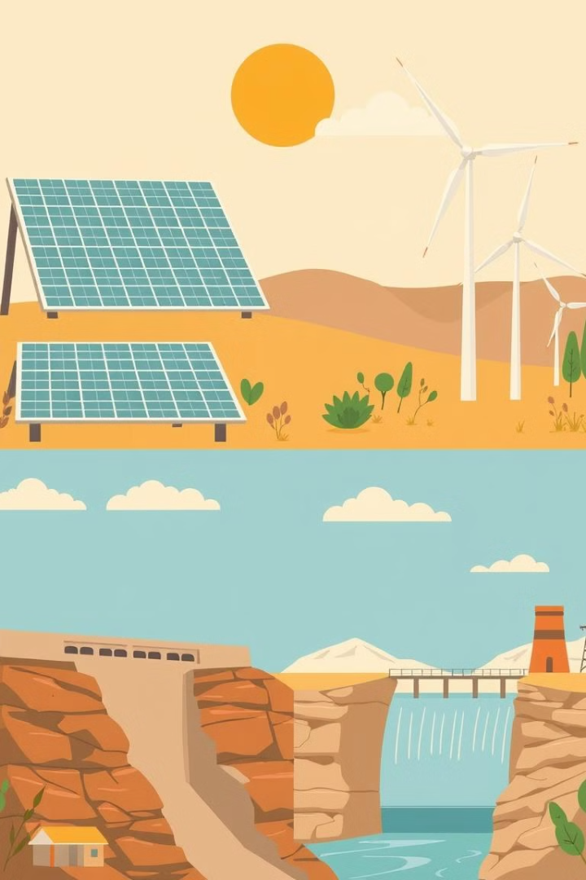
Green Technologies and Innovation
Green technologies are crucial for environmental sustainability and economic growth. They minimize negative impacts, promote efficiency, and reduce carbon footprints.
Renewable Energy Technologies:
Solar Power
PV panels convert sunlight into electricity.
Wind Energy
Wind turbines harness wind power.
Hydropower
Water turbines generate electricity.
Geothermal Energy
Heat from the Earth generates power.
Source :
Images are generated by AI tool
Notes:
Green Technologies and Innovation
Green technologies and innovations are essential for addressing environmental challenges while driving sustainable economic growth. These technologies minimize negative environmental impacts, promote resource efficiency, and offer innovative solutions for industries, governments, and individuals to reduce their carbon footprint.
Definition and Importance of Green Technologies
Green Technologies and Innovation refer to the development and application of environmentally friendly and sustainable technologies aimed at addressing environmental challenges like climate change, resource depletion, and pollution.
Green technologies help achieve sustainability goals by reducing carbon emissions, conserving natural resources, and promoting renewable energy sources.
Examples:
Adoption of solar panels and wind turbines for clean energy generation.
Development of electric vehicles (EVs) to reduce transportation-related emissions.
Renewable Energy Technologies
Solar Power: Photovoltaic (PV) panels convert sunlight into electricity, offering a renewable and abundant source of energy. Innovations in solar panel efficiency, storage solutions, and solar farms have driven the expansion of solar power worldwide.
Wind Energy: Wind turbines harness wind power to generate electricity. Offshore and onshore wind farms contribute significantly to renewable energy portfolios, with innovations focusing on improving turbine efficiency and integration into power grids.
Hydropower: Water turbines convert the kinetic energy of flowing water into electricity. Hydropower technologies focus on improving dam efficiency and developing low-impact, small-scale hydro projects that minimize environmental disruptions.
Geothermal Energy: Extracting heat from the Earth’s crust to generate electricity and provide direct heating solutions. Geothermal power plants are expanding, with innovations in drilling and resource identification improving access to this renewable energy source.
Biomass and Bioenergy: Biomass (organic material) is used to produce biofuels and bioenergy. Technologies like anaerobic digestion and biomass gasification provide renewable energy while reducing waste and promoting circular economy practices.

Slide 16
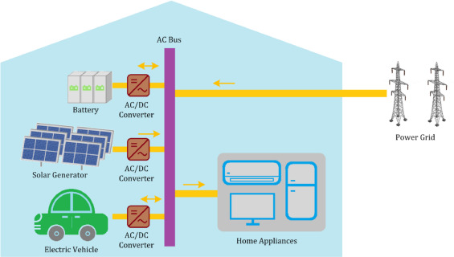
Green Technologies and Innovation
Energy Storage and Smart Grids:
Battery Technologies
Advancements in lithium-ion and solid-state batteries.
Smart Grids
Intelligent power distribution systems.
Energy Storage Systems
Large-scale storage for renewable energy
Source :
https://www.sciencedirect.com/science/article/abs/pii/S2352152X21003340
Notes:
Energy Storage and Smart Grids
Battery Technologies: Advancements in battery storage systems, such as lithium-ion and solid-state batteries, enable more efficient storage of renewable energy for use when the sun isn’t shining or the wind isn’t blowing. Innovations focus on improving energy density, reducing costs, and ensuring safety.
Smart Grids: Intelligent power distribution systems that optimize energy use by managing electricity demand, integrating renewable sources, and ensuring grid stability. Smart grids rely on data, sensors, and automation to enhance energy efficiency and reduce energy loss.
Energy Storage Systems (ESS): Large-scale storage systems (e.g., pumped hydro, thermal storage) allow excess renewable energy to be stored and used later, increasing the reliability of renewable energy supplies.
Examples:
Tesla Powerwall and other home energy storage solutions that enable households to store solar energy for later use.
Smart meters that monitor and optimize energy consumption in real time.

Slide 17
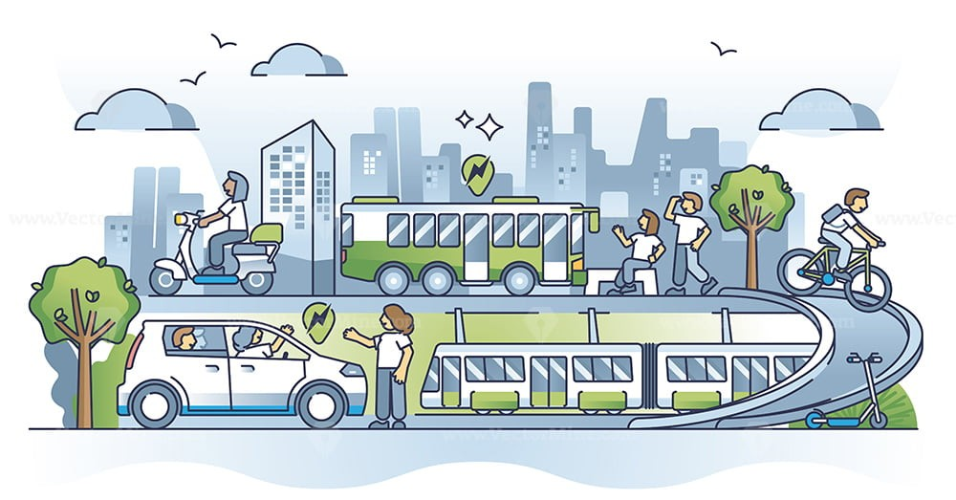
Green Technologies and Innovation
Green Transportation
Electric Vehicles
Reduce greenhouse gas emissions.
Hydrogen Fuel Cells
Produce electricity with water as byproduct.
Sustainable Aviation
Reduce air travel's carbon footprint
Source :
https://www.linkedin.com/pulse/advancing-sustainable-transportation-south-africa-pathway
Notes:
Green Transportation Technologies
Electric Vehicles (EVs): EVs are powered by electricity instead of fossil fuels, significantly reducing greenhouse gas emissions. Innovations in battery technology, charging infrastructure, and autonomous driving are driving the widespread adoption of EVs.
Hydrogen Fuel Cells: Hydrogen-powered fuel cells produce electricity through a chemical reaction, with water as the only byproduct. Fuel cell technology is being explored for transportation applications, especially in heavy-duty vehicles, buses, and long-haul trucks.
Sustainable Aviation: Electric and hybrid-electric aircraft, as well as sustainable aviation fuels (SAF), are reducing the carbon footprint of air travel. Innovations focus on improving fuel efficiency and developing alternative propulsion systems.
Shared Mobility and Smart Transportation: Car-sharing platforms, bike-sharing systems, and autonomous vehicles contribute to reducing traffic congestion, emissions, and the environmental impact of personal transportation.
Examples:
The rise of electric vehicles such as Tesla, Nissan Leaf, and Rivian, and their impact on reducing emissions.
Hydrogen-powered buses and trains being implemented in regions like Japan and Europe.

Slide 18
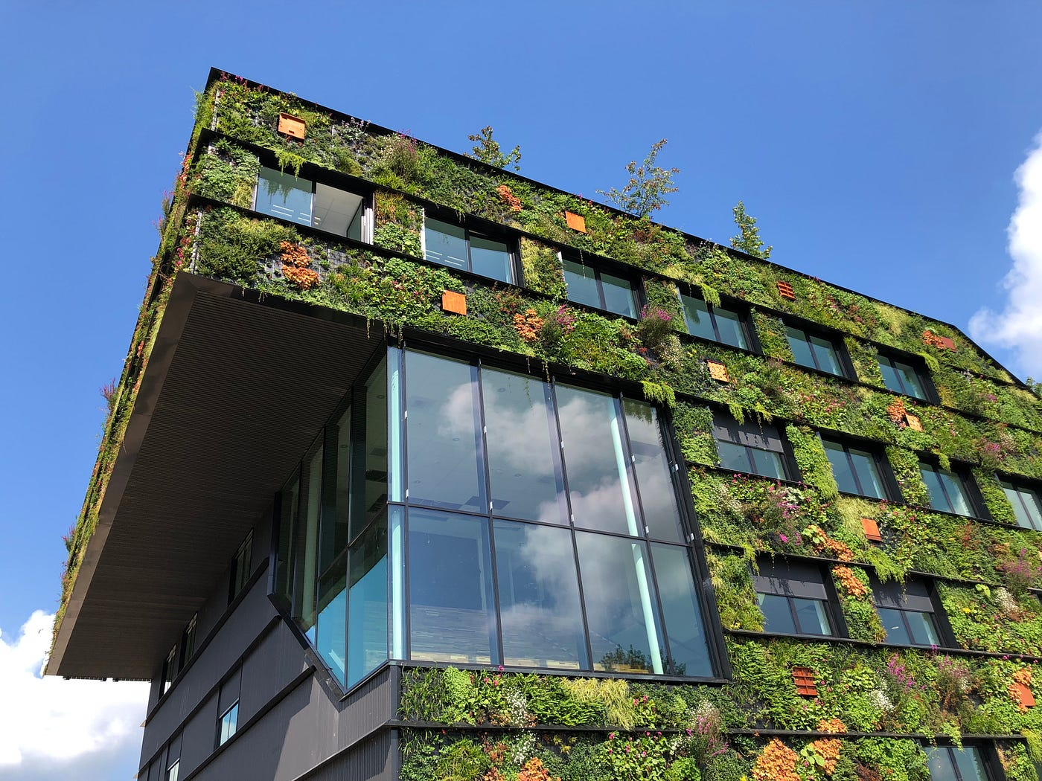
Green Technologies and Innovation
Green Building Technologies
Energy-efficient Buildings
Minimize environmental impact.
Green Roofs
Reduce heat islands, improve air quality.
Sustainable Materials
Reduce construction's environmental footprint.
Source :
https://medium.com/@apurvawagh/green-building-technology-the-future-of-sustainable-construction-ead58fa05699
Notes:
Green Building Technologies
Energy-efficient Buildings: Green buildings incorporate sustainable materials, energy-efficient systems, and renewable energy sources to minimize their environmental impact. Innovations include smart HVAC systems, passive solar design, and advanced insulation materials.
Green Roofs and Vertical Gardens: Installing vegetation on rooftops or building facades to reduce heat islands, improve air quality, and promote biodiversity. Green roofs also offer insulation, reduce stormwater runoff, and provide urban green spaces.
Sustainable Construction Materials: The use of recycled materials, low-carbon cement, and sustainable wood products reduces the environmental footprint of construction. Innovations in prefabricated building components and 3D printing also enhance resource efficiency.
Examples:
LEED-certified buildings that meet high environmental standards for energy efficiency and sustainability.
Smart buildings equipped with IoT systems that optimize lighting, heating, and ventilation based on occupancy and external conditions.

Slide 19
Green skilling and its importance in the context of sustainability
Chapter
2

Slide 20

AI Technologies for Sustainability
AI transforming sustainability through machine learning, natural language processing, robotics, and predictive analytics.
Source :
https://itcc.ieee.org/event/tackling-sustainability-through-the-ai-lifecycle/
Notes:
AI is playing a significant role in transforming sustainability by integrating advanced technologies such as machine learning (ML), natural language processing (NLP), robotics, and predictive analytics across various sectors.
AI technologies like machine learning, NLP, robotics, and predictive analytics are driving sustainable practices by enhancing efficiency, reducing waste, and promoting eco-friendly decisions. These advancements allow industries and governments to better understand and mitigate environmental challenges, resulting in a more sustainable and resilient future. By leveraging these technologies, we can accelerate the transition toward a more sustainable world, with AI serving as a key enabler of change.

Slide 21
AI Technologies for Sustainability
Machine Learning
Patterns and Prediction
AI learns from data to model climate, optimize resources, and manage renewable energy.
Grid Management
Controlling variable wind and
solar energy supplies for power grids.
1
2
3
Weather Forecasting
Predicting renewable energy production
based on weather data.
Source :
Notes:
Machine Learning
It basically allows learning of patterns in data and prediction by systems through a core technology called machine learning, which is very important in climate change modeling, resource optimization, and renewable energy management through actionable insights for actions on the road to a sustainable practice.
For instance, the Weather Company, which is affiliated with IBM, applies models of machine learning from this company for predictions of renewable energy production according to weather forecasts, thus in turn allowing the control and management of variable supplies of wind and solar sources by power grids.

Slide 22
AI Technologies for Sustainability
Natural Language Processing
Sustainability Reporting​
Extracting insights from climate and sustainability reports across industries.​
Policy Analysis​
Interpreting scientific literature and sustainability policy documents.​
Decision Support​
Providing data-driven recommendations to sustainability decision-makers.​
Source :
Notes:
Natural Language Processing (NLP)
NLP lets AI decode human language and apply the meaning as such, which should be helpful in reading sustainability reports and policy documents; it can also be useful for the interpretation of scientific literature. Automatic extraction from a mountain of text to understand difficult issues of sustainability better for the decision-maker is what the process offers.
Example: AI for Sustainability Reporting NLP tools, like Climate BERT, help companies and researchers extract key insights from climate and sustainability reports that are easier to analyse across industries regarding trends and outcomes.

Slide 23
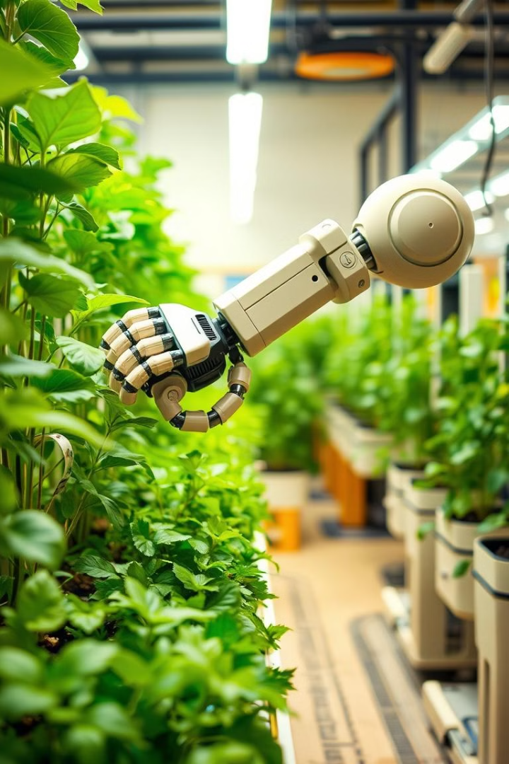
AI Technologies for Sustainability
Robotics and Automation
Precision Farming
Robots implementing sustainable agriculture practices, saving resources.
Energy-Efficient Manufacturing
Automating processes to reduce waste and environmental
impact.
Recycled Automation
Using recycled materials to build sustainable robotic systems.
Source :
Image generated by AI tool
Notes:
Robotics and Automation
Robotics, backed by AI, is fostering more sustainable processes through the implementation of precision farming, energy-efficient manufacturing, and recycled automation.
Example: Vertical Farming Robots Using AI, robots run vertical farms in cities like Tokyo by planting, watering, and harvesting crops within climate-controlled environments, saving water and fertilizers by several folds and boosting yields.

Slide 24
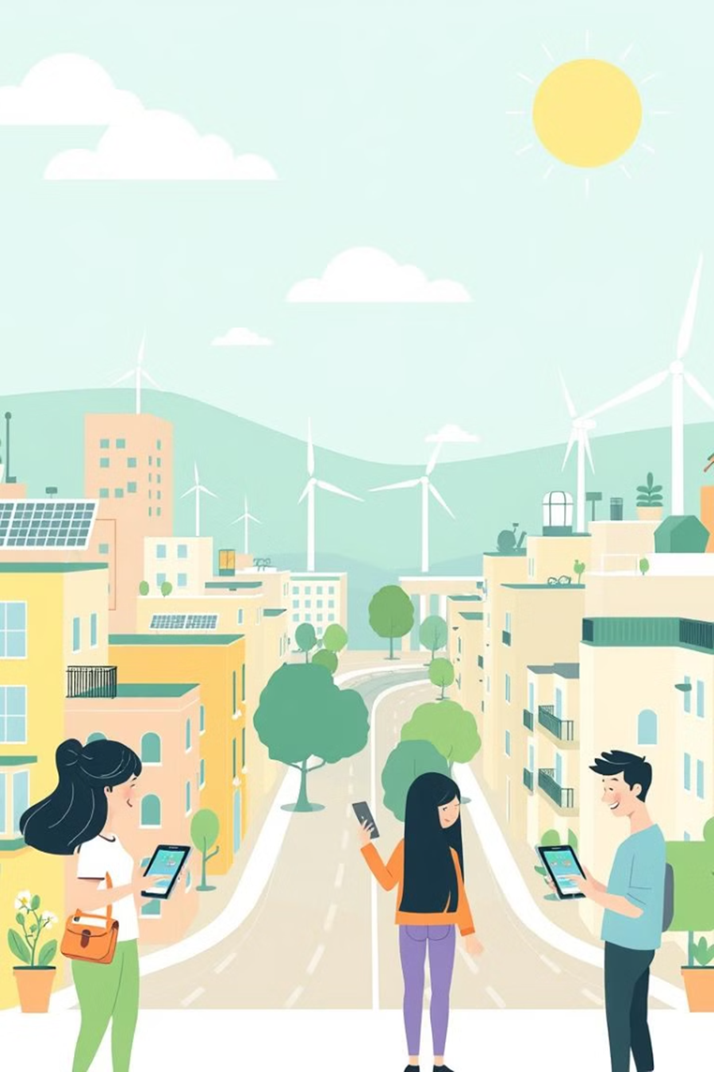



AI Technologies for Sustainability
IoT and AI Integration
Real-Time Data
Collecting sensor data from connected devices.
Optimization
Analyzing data to optimize resource management.
Smart Systems
Automating sustainable practices in cities, agriculture, and energy.
Source :
Image generated by AI tool
Notes:
IoT and AI Integration
The integrating of IoT devices with AI allows collecting data from connected devices in real-time and optimizing systems for resource management. It is considerably important for smart cities, agriculture, and energy systems.
Example: Smart Water Management: Cape Town is under observation, using IoT sensors to measure water levels in reservoirs while the AI system analyses data for optimization of usage and preventing a shortage. The schedule of irrigation is managed by AI systems and saves water during a drought season.

Slide 25


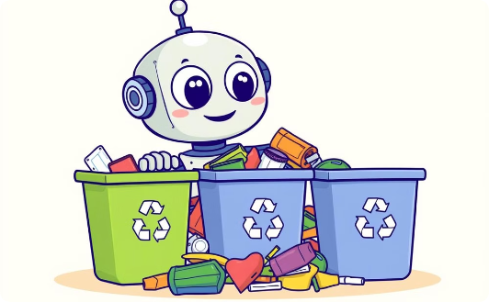
AI Technologies for Sustainability
Computer Vision
Environmental Monitoring
Wildlife Tracking
Waste Management
Analyzing satellite and drone data to detect threats.
Automating species identification from camera trap footage.
Improving recycling and sorting through computer vision.
Source :
Images are generated by AI tool
Notes:
Computer Vision
AI's computer vision technology is pretty instrumental in analysing images and video for many applications in sustainability such as wildlife monitoring, detecting deforestation, and waste sorting.
Example: AI-Driven Environmental Monitoring Environmental authorities receive an alert in real time from AI models which analyzed satellite imagery of the Amazon rainforest and found illegal clearing of forests, and thus, the authorities intervene before critical damage happens.
AI would transform everything for a more advantageous future in responding to sustainability challenges-from maximising energy use and mitigating climate change to food and biodiversity security. But as AI is a multi-faceted tool, it calls for more cooperation between the public, private, and people sectors to "fully unlock its potential." Ethical considerations like data privacy and algorithmic fairness have to be covered so that the benefits of this technology reach the full extent of society, particularly the poor and the other marginalized groups. As AI continues to improve and is rolled out thoughtfully, it should become a catalyst for human advancement toward a sustainable future.

Slide 26

AI for Biodiversity
1
Species Identification
AI-powered camera traps and apps for rapid species detection.
2
Habitat Monitoring
Satellite and drone analysis to track ecosystem health.
3
Combating illegal wildlife trade and poaching
AI models predicting poaching risks to guide enforcement.
4
Enhancing Citizen Science for Biodiversity
AI-enabled platforms engaging the public in data collection.
Source :
https://www.safeworldhse.com/2020/04/biodiversity-types-importance-loss-conservation.html
Notes:
Species Identification and Tracking
Species identification and tracking are among the most important areas in biodiversity conservation, though it often requires a lot of human expertise to settle the resolution, such identification becomes challenging, especially in remote or inaccessible areas. AI-driven computer vision and machine learning technologies revolutionize the way species identification and tracking are being done-that is, much more rapidly and accurately.
Example: Machine-Learning Camera Traps Machine-learning camera traps are becoming more popular in biodiversity hotspots, such as in the Amazonian rainforest or African savannas. Such camera traps automatically identify species from images and videos captured by applying machine learning algorithms, thereby saving a lot of time and effort compared with carrying out the process manually. For instance, the Wildlife Insights platform uses AI to automatically analyze millions of camera trap images, deduce the animals present, and their counts. This wonderfully hastens research such that instead of taking a long-time gathering data, scientists can analyze it.
Example: Bird Identification Apps Merlin Bird ID app, developed by Cornell Lab of Ornithology, uses machine learning algorithms in its effort to assist users in identifying the type of birds through photographs or audio recordings. The method is capable of using large databases on bird sounds and images for direct identification of species. This helps citizen science and biodiversity databases in terms of species identification.
Habitat and Ecosystem Monitoring
Habitat and ecosystem monitoring are very important through AI. For conservation purposes, one needs to understand how ecosystems work and how they differ over time. The functioning and transformations in ecosystems can be understood by analyzing data from satellites, drones, and environmental sensors through AI systems, which can show whether the habitat is in good health or changes in land use and degradation of the environment.
Example: AI Habitat Analysis Based on Remote Sensing AI analyzes satellite imagery and drone footage about habitat tracking in real time. For instance, AI algorithms can identify the probability of deforestation and wetlands degradation, together with coral bleaching through detection of the early changes in forest cover, wetlands, and coral reefs. AI models are using satellite data to track the health condition of coral from the Great Barrier Reef and predict future bleaching events so that early intervention is possible.
Example: Detection of Deforestation AI systems in the Amazon are combating illegal logging through the analysis of satellite images to detect deforestation patterns. The Global Forest Watch platform is enabled through AI and continuously monitors changes in forests using satellite data. It sends alerts to conservationists and governments whenever deforestation activities are spotted. This has greatly boosted the enforcement efforts of protecting forests, which are vital for biodiversity preservation.
Combating illegal wildlife trade and poaching
Some of the biggest threats to biodiversity are carried out in illegal wildlife trade and poaching. These actions bring most species on Earth nearer to extinction. In this regard, AI has played a growing role in the area, providing tool support for the real-time monitoring and detection of illegal activities.
Example: AI-Powered Anti-Poaching Systems PAWS (Protection Assistant for Wildlife Security) is an artificial intelligence-enhanced surveillance system. PAWS uses past poaching cases and environmental knowledge and then processes this information to create risk maps that tell rangers on which routes to patrol first. Such a predictive model has applied in national parks within Uganda and Cambodia, among other states, and yields lesser rates of poaching.
Example: AI for Wildlife Trafficking Detection AI is deployed in border control and customs to scan out illegal wildlife trafficking. Such machine learning models trained on images of trafficked wildlife products such as ivory, rhino horn, or pangolin scales are incorporated into the X-ray scanning systems to detect banned shipments. WITS utilizes AI for analysis of global data on wildlife trade, thereby assisting the authorities in tracking and intercepting more effectively the illegal networks.
Enhancing Citizen Science for Biodiversity
Citizen science is a strong approach to scaling biodiversity data collection: volunteers helping in the process of data collection on species and ecosystems. AI has been applied so as to scale efforts in citizen science in a manner where it becomes easier for non-experts to contribute meaningfully towards biodiversity conservation projects.
Example: AI-Fueled Biodiversity Hubs Platforms like iNaturalist uses AI to assist citizen scientists in plant and animal species identification based on photographs. The platform has leaned on millions of images that have been trained by machine learning models, and the system's suggested species identifications are validated by experts. It has turned what was once a time-consuming and inaccurate method of species data collection into lightning-fast, incredibly accurate - instant species-identification research tool in an instant to create a global biodiversity database for researchers and conservationists to make use of.
Example: Real-Time Data Collection in Marine Environments Citizen science also uses AI to scan marine biodiversity. For instance, Seasearch is an application where divers and snorkelers can submit their marine species observations. The application thereafter processes the submissions to identify trends in marine biodiversity in the ecosystem to enable scientists to understand what are affecting kelp forests and other habitats.

Slide 27

AI for Biodiversity
5
Predictive Modeling for Ecosystem Management
AI-driven predictive models enable conservationists and policymakers to predict how ecosystems would change and prepare to minimize biodiversity loss.
6
Restoration of Ecosystems
AI technologies for the restoration of degraded or destroyed ecosystems
Source :
https://gamecarepro.com/pages/greener-world-together
Notes:
Predictive Modeling for Ecosystem Management
AI-driven predictive models enable conservationists and policymakers to predict how ecosystems would change and prepare to minimize biodiversity loss. These models can predict how ecosystems would react to environment pressures, such as climate changes, habitat loss, or species invasion, helping in better management techniques.
Example: Predicting Changes in Species Distribution Due to Climate Change Predictive models of AI are being used to predict changes in species distributions due to climate change. Environmental data, such as temperature, rain, and land use, machine learning models apply to predict where species are likely to migrate as their habitats change. This means providing information that enables them to prepare conservationists for new protected areas or wildlife corridors that can enable species to move to fit changing conditions. For example, AI models are being applied in Australia to predict how ranges of marsupials- such as the koala- will change due to climatic change and thereby inform habitat restoration efforts and protection.
Example: Artificial Intelligence is aiding the managing of invasive species which threaten native biodiversity severely. Based on environmental conditions, transport networks, and human activities, machine learning algorithms can predict where invasive species are likely to spread. In return, this enables targeting eradication or containment efforts more effectively. AI models are used in the Galápagos Islands to predict and prevent the spread of invasive species like rats and goats threatening native species there, such as giant tortoises.
VI. Restoration of Ecosystems
Restoration of degraded or destroyed ecosystems is also another critical activity in biodiversity conservation. It employs AI technologies to guide and optimize interventions, thus revealing where they should occur most urgently and how they should happen.
Example: AI for Re-forestation AI systems are supporting reforestation projects by the analysis of satellite data which aids in determining where trees should be planted. Dendra Systems uses AI-powered drones to plant trees in areas deforested in the United Kingdom. They do not only plant seeds but track the new trees growing to ensure that reforestation activities are successful.
Example: Coral Reef Restoration AI is helping to rehabilitate bleached, polluted, or destroyed coral reefs due to destructive forms of fishing practices in marine ecosystems. The best sites for the restoration of corals can be determined using AI-based models analyzing oceanographic data and assessing the health of transplanted corals. For example, an AI application can be used by Coral Vita, a coral restoration project, in optimizing the growth conditions for more resilient coral species to damaged reef ecosystems as part of their restoration processes.

Slide 28




AI Technologies for Sustainability
Predictive Analytics
Climate Modeling
Energy Demand
Resource Availability
Predicting environmental scenarios to mitigate climate risks.
Forecasting energy needs to optimize supply and distribution.
Anticipating resource scarcity to inform sustainable practices.
Source :
Image generated by AI tool
Notes:
Predictive Analytics
In addition, AI-based predictive analytics models predict upcoming environmental scenarios, including energy demand, climate conditions, or availability of resources. It provides proactive decision and preparation for sustainability challenges.
Example: Climate Risk Models Based on AI models, like ClimateAI, governments and businesses can predict the risk of climate change upon infrastructure, agriculture, and public health, providing critical data to mitigate those risks effectively.

Slide 29
AI Technologies Driving Biodiversity Conservation
Machine Learning & Deep Learning:
AI algorithms like CNNs identify species from camera trap footage and citizen images, as used by platforms like iNaturalist.
Computer Vision:
AI-powered drones and satellites analyze visual data for wildlife tracking, such as monitoring elephant populations in Africa.
Natural Language Processing (NLP):
Automates the analysis of literature and reports, helping researchers gather information on species and conservation strategies.
Predictive Analytics:
AI models predict future trends in species distribution and the impact of climate change, guiding conservation efforts for vulnerable species.
Source :
Notes:
AI Technologies Driving Biodiversity Conservation
I. Machine Learning and Deep Learning
Most AI-based biodiversity applications are based on machine learning and deep learning algorithms. Such systems can recognize patterns and predict enormous datasets-essentials in biodiversity research and conservation.
For example, AIs for Species Identification: Machine Learning models, for example, such as Convolutional Neural Networks (CNNs), are strongly designed and used by image recognition systems in the identification of species from camera trap footage or citizen-submitted pictures. These technologies basically ensure that the success of the platform-of-iNaturalist rests on them and have thereby made biodiversity conservation easier to participate in for non-experts.
II. Computer Vision
Computer vision is one of the subfields of AI that allows machines to interpret visual information based on images and videos. Biodiversity monitoring requires camera traps, drones, and satellites that deliver an enormous amount of visual data and must be analyzed rapidly and with accuracy.
Example: Tracking Wildlife Across Remote Terrain AI-powered drones with computer vision monitor wildlife in remote or inaccessible terrain. Conservationists in Africa use drones to survey populations of elephants live-time as AI deduces the number of individuals and their movement.
III. Natural Language Processing (NLP)
NLP enables an AI system to process and understand human language and, therefore, helps with gathering information from literature, reports, and databases in biodiversity.
Example: Automating Literature Reviews With the use of AI tools that use NLP, it is possible to analyze thousands of scientific papers to extract key information on species, ecosystems, and strategies for the conservation of biodiversity, whereby researchers can keep track of all work being developed in the area.
IV. Predictive Analytics
It is necessary to use AI in predictive analytics on biodiversity and changes in the health of the ecosystem. Using such data, AI models are able to predict the future scenarios with trends and changes in species distribution, ecosystem services, and environmental conditions based on historical and real-time data analysis.
Example: Predictions of Impact on Climate Change AI-driven climate models predict the impact of a rise in temperatures, change in rainfalls, and extreme patterns of weather on different species and ecosystems. Conserving the more vulnerable species for an uncertain future will be able to prepare.

Slide 30
Green Entrepreneur
Chapter
3

Slide 31
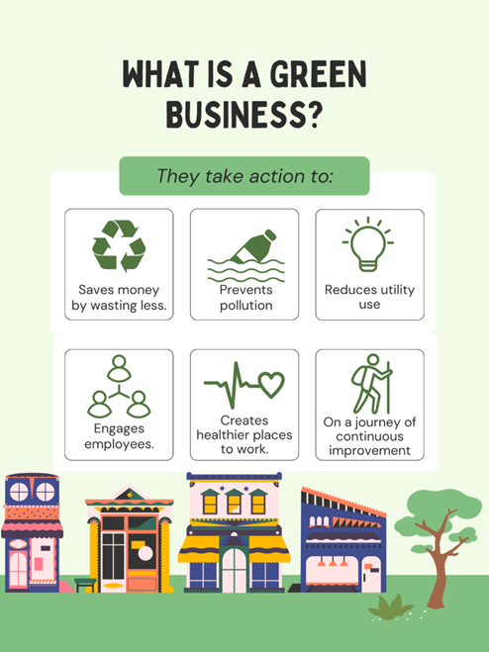
Green Entrepreneurship
Ecopreneurship, or green entrepreneurship, is a new term for academic research.
This phenomenon began in the 1970s, but it received the attention of the researchers in the 1980s and 1990s.
Green entrepreneurship can be defined as the entrepreneurship that is aimed at inventing and executing solutions to environmental problems and bring social change for development of green and sustainable economies.
https://www.linkedin.com/pulse/rise-green-entrepreneurship-hrinsights2020-ip6sf/

Slide 32
Why Green Entrepreneurship ?
Green entrepreneurs are currently very important for the development of the economy because they help in creating new jobs, introducing sustainable innovations in the markets, and responding to the demands for change in society.
Green entrepreneurs can be seen as change agents and drivers of sustainability and social change.
Green products are designed in such a manner that there is lesser use of natural resources, elimination of toxic waste substances that can be harmful to environment and human health, recycling of waste material and reduction in consumption of energy.
Source :
https://www.allcommercejournal.com/article/153/4-1-26-689.pdf

Slide 33
Green Entrepreneurship in India
Case Study: Phool. Co
Overview: Phool.co transforms floral waste into sustainable products.
Business Model: Collects floral waste from temples and creates incense sticks, bio-leather, and other products.
Sustainability Practices: Reduces waste, promotes recycling, and provides employment to local women.
Impact: Prevents river pollution, creates jobs, and promotes circular economy.
Achievements: Awarded the United Nations Young Leaders Award, featured in Forbes 30 Under 30.

Slide 34
Green Entrepreneurship in India
Case Study: Mitticool Clay
Overview: Mitticool produces eco-friendly clay products like refrigerators, water bottles, and cookware.
Business Model: Utilizes traditional clay craftsmanship to create sustainable and affordable alternatives to plastic and metal products.
Sustainability Practices: Uses natural materials, promotes traditional craftsmanship, and reduces carbon footprint.
Impact: Provides eco-friendly household products, supports local artisans, and promotes sustainable living.
Achievements: Recognized by the National Innovation Foundation, featured in various national and international media.

Slide 35
Green Entrepreneurship in India
Case Study: Bare Necessities
Overview: Bare Necessities focuses on zero-waste personal and lifestyle products.
Business Model: Offers sustainable alternatives to everyday products, including personal care, home care, and lifestyle accessories.
Sustainability Practices: Zero-waste production, plastic-free packaging, and ethical sourcing.
Impact: Reduces plastic waste, educates consumers on sustainability, and supports fair trade.
Achievements: Awarded the Circular Economy Pioneer by the World Economic Forum, featured in TED Talks and major publications.

Slide 36
Role of Government and Policy Support
Policies and Initiatives
Standup India Schemes
Financial Incentives for Sustainable Practices
Green Skill Development Program (GSDP)
National Clean Energy Fund (NCEF)
Notes:
These schemes provide funding support, mentorship, and resources to startups, including green startups.
Special focus on underrepresented groups, encouraging inclusivity in green entrepreneurship.
Financial Incentives for Sustainable Practices:
Subsidies and low-interest loans for companies adopting renewable energy and sustainable practices.
Grants and tax breaks for research and development in green technologies.
Green Skill Development Program (GSDP):
Government initiative to train and certify individuals in various green skills, fostering a skilled workforce for green industries.
Courses on solar energy, waste management, organic farming, etc.
National Clean Energy Fund (NCEF):Finances innovative green projects aimed at reducing carbon emissions.
Supports renewable energy projects, cleaner technologies, and waste-to-energy initiatives.

Slide 37
Role of Government and Policy Support
Examples of Support
Subsidies for Renewable Energy Projects:
Tax Benefits for Eco-Friendly Businesses:
Public-Private Partnerships (PPP):
Swachh Bharat Abhiyan (Clean India Mission):
Notes:
Subsidies for Renewable Energy Projects:
Financial assistance for installing solar panels, wind turbines, and other renewable energy sources.
Net metering policies allowing businesses to sell excess power back to the grid.
Tax Benefits for Eco-Friendly Businesses:
Income tax deductions for companies using energy-efficient equipment and renewable energy sources.
GST reductions on eco-friendly products like electric vehicles, solar panels, and energy-saving appliances.
Public-Private Partnerships (PPP):
Collaboration between the government and private sector to develop and scale green technologies.
Examples include solar parks, green building initiatives, and waste management projects.
Swachh Bharat Abhiyan (Clean India Mission):
Promotes cleanliness and waste management across the country.
Provides funding and support for startups focusing on waste reduction, recycling, and sanitation.

Slide 38

Case Study
Hands On
Case Study
Green Skilling for Sustainable Energy Transition

Slide 39

Conclusion
The presentation highlights the critical role of green skilling in achieving a sustainable future.
Through environmental awareness and literacy, individuals and organizations can make informed decisions that reduce their ecological and carbon footprints.
By integrating sustainable practices into various sectors such as energy, agriculture, and urban planning and leveraging green technologies, we can address global challenges like climate change while fostering economic growth.
The collective effort of governments, institutions, and communities is essential to ensuring that we meet the needs of the present without compromising the ability of future generations to meet theirs.
Source :
www.freepik.com/

Slide 40
References
https://www.weforum.org/agenda/2024/02/green-jobs-green-skills-growth/
https://www.british-assessment.co.uk/what-is-sustainable-resource-management-and-how-do-you-achieve-it/
https://www.investopedia.com/terms/g/green_tech.asp
https://www.doe.virginia.gov/teaching-learning-assessment/instruction/environmental-literacy
https://earth.org/climate-change/
https://earth.org/environmental-education/
https://www.britannica.com/topic/environmental-policy/Global-policy-agreements

Slide 41


Let’s Start

Slide 42


Quiz
Which of the following is a key component of environmental literacy?
a) Knowledge of technological advancements
b) Awareness and sensitivity to environmental problems
c) Ability to calculate personal finances
d) Understanding global financial systems
Answer: b
Awareness and sensitivity to environmental problems

Slide 43
Quiz
2. What is an ecological footprint?
a) The total amount of carbon emissions produced
b) The amount of biologically productive land and water needed to support one’s lifestyle
c) The distance a person travels to work
d) The sum of waste produced by a community
Answer: b
The amount of biologically productive land and water needed to support one’s lifestyle

Slide 44
Quiz
3. What are the three pillars of sustainability?
a) Environmental sustainability, economic sustainability, social sustainability
b) Financial sustainability, energy sustainability, social stability
c) Government policies, technological development, energy use
d) Climate change, population control, resource management
Answer: a
Environmental sustainability, economic sustainability, social sustainability

Slide 45
Quiz
4. Why is sustainability important?
a) To maximize short-term profits
b) To promote responsible use of natural resources and ensure the well-being of future generations
c) To avoid global financial crises
d) To create competition among businesses
Answer: b
To promote responsible use of natural resources and ensure the well-being of future generations

Slide 46
Quiz
5. How can community engagement help enhance environmental awareness?
a) By focusing only on waste management
b) Through increased industrial growth
c) By ignoring government policies
d) Through workshops, clean-up projects, and sustainability initiatives
Answer: d
Through workshops, clean-up projects, and sustainability initiatives

Slide 47
Quiz
6. What is the primary focus of green entrepreneurship?
Maximizing profits
b) Reducing environmental footprint
c) Expanding market share
d) Enhancing brand visibility
Answer: B

Slide 48
Quiz
7. Which company is known for transforming floral waste into sustainable products?
a) Mitticool Clay
b) Bare Necessities
c) Phool.co
d) Solar Energy Corporation of India
Answer: C

Slide 49
Quiz
8. The Green Skill Development Program (GSDP) is designed to:
a) Train individuals in various green skills
b) Fund large-scale industrial projects
c) Develop traditional businesses
d) Increase consumer spending
Answer: A

Slide 50
Thank You
Notes:
Thank You !!

